Slide 1

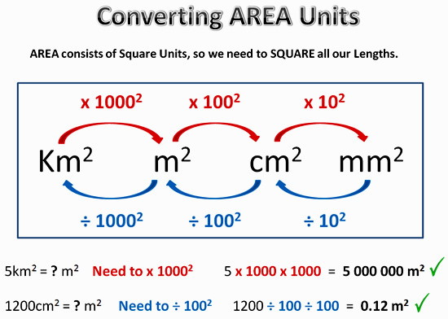
My Measurement Interactive Notebook
Name
Class
Teacher Mr Evans
Term 1 Semester 1
1

Slide 2
Contents
Glossary or Formula Page
Page
Date
Description
2
3

Slide 3
Tasks
24
7
30
Essential Question
Questions
Notes
Summary
6
7

Slide 4
Area
Area measures the surface of something
1 metre
1 cm
1 mm
1 metre
1 m²
1 mm
1 mm²
1 cm
1 cm²
1 square metre

Slide 6
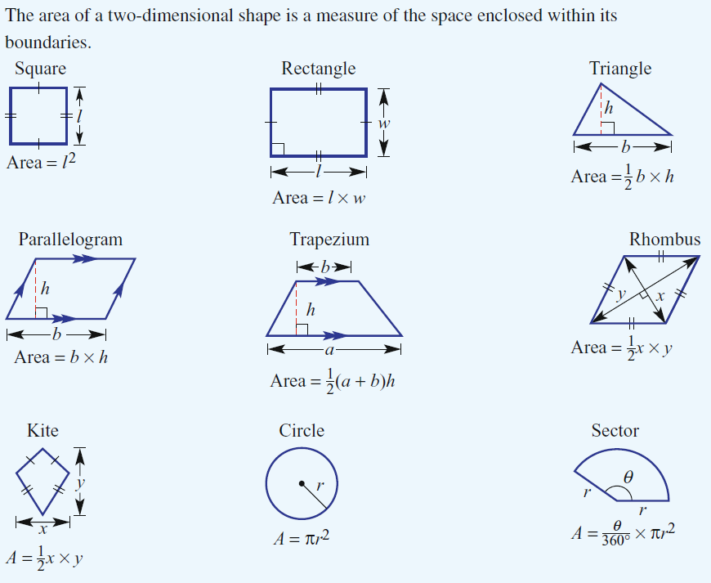
24
7
30
Date
Area
EQ – How do I find the area of different shapes?
How do we find the area of 2 dimensional shapes?
5

Slide 7
4cm
9cm
9cm
12cm
9cm
9cm
8cm
13cm
2cm
3cm
10cm
5cm
6cm
4cm
14cm
11cm
12cm
5cm
7cm
12cm
13cm
1cm

Slide 8
Calculate the area of the following shapes.
3)
10cm
1)
2)
6cm
7cm
4cm
7cm
8cm
7cm
9cm
13m
3cm
12cm
8cm
4)
3cm
4cm
5)
6)
8cm
5cm
5cm
6cm
7cm
6cm
2cm
3cm
7cm
7)
8)
6cm
15cm

Slide 9
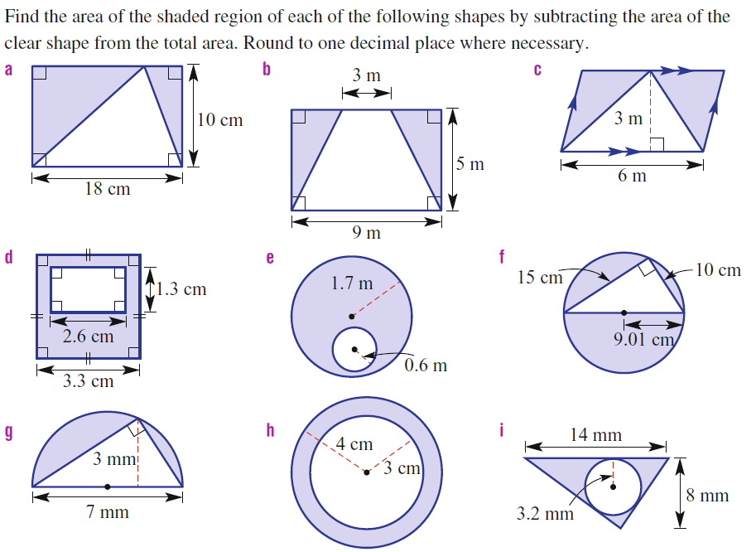
Answers

Slide 10
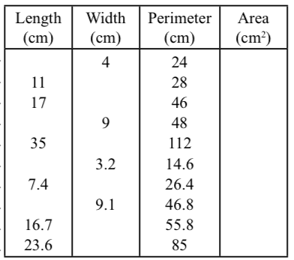
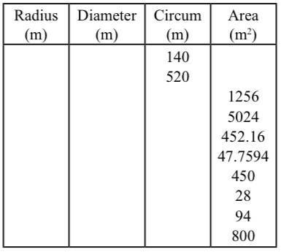
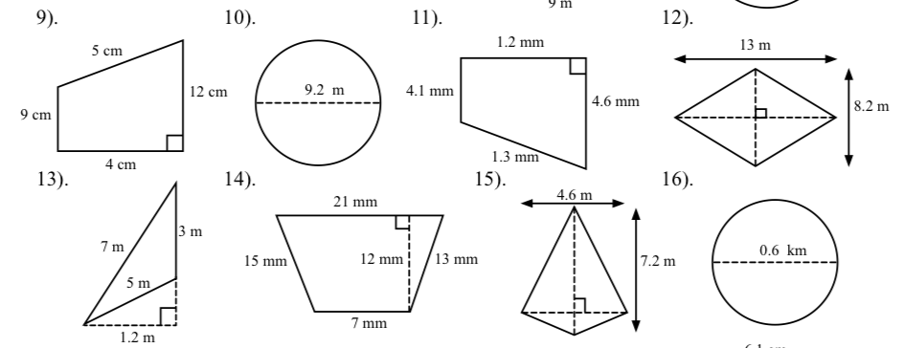
Extension Questions
Complete the Tables

Slide 11
Notes Review
24, 7 ,30
Date
Title
Essential question
Notes complete
Notes complete with colour and diagrams
Questions completed
Contents page filled in
Formula page filled in

Slide 12
Homework
Review your notes and write a summary answering the essential question.

